Slide 1
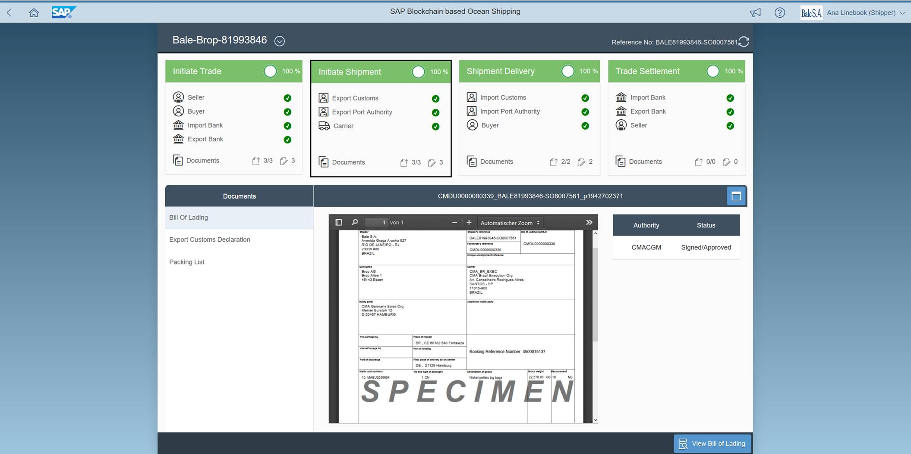




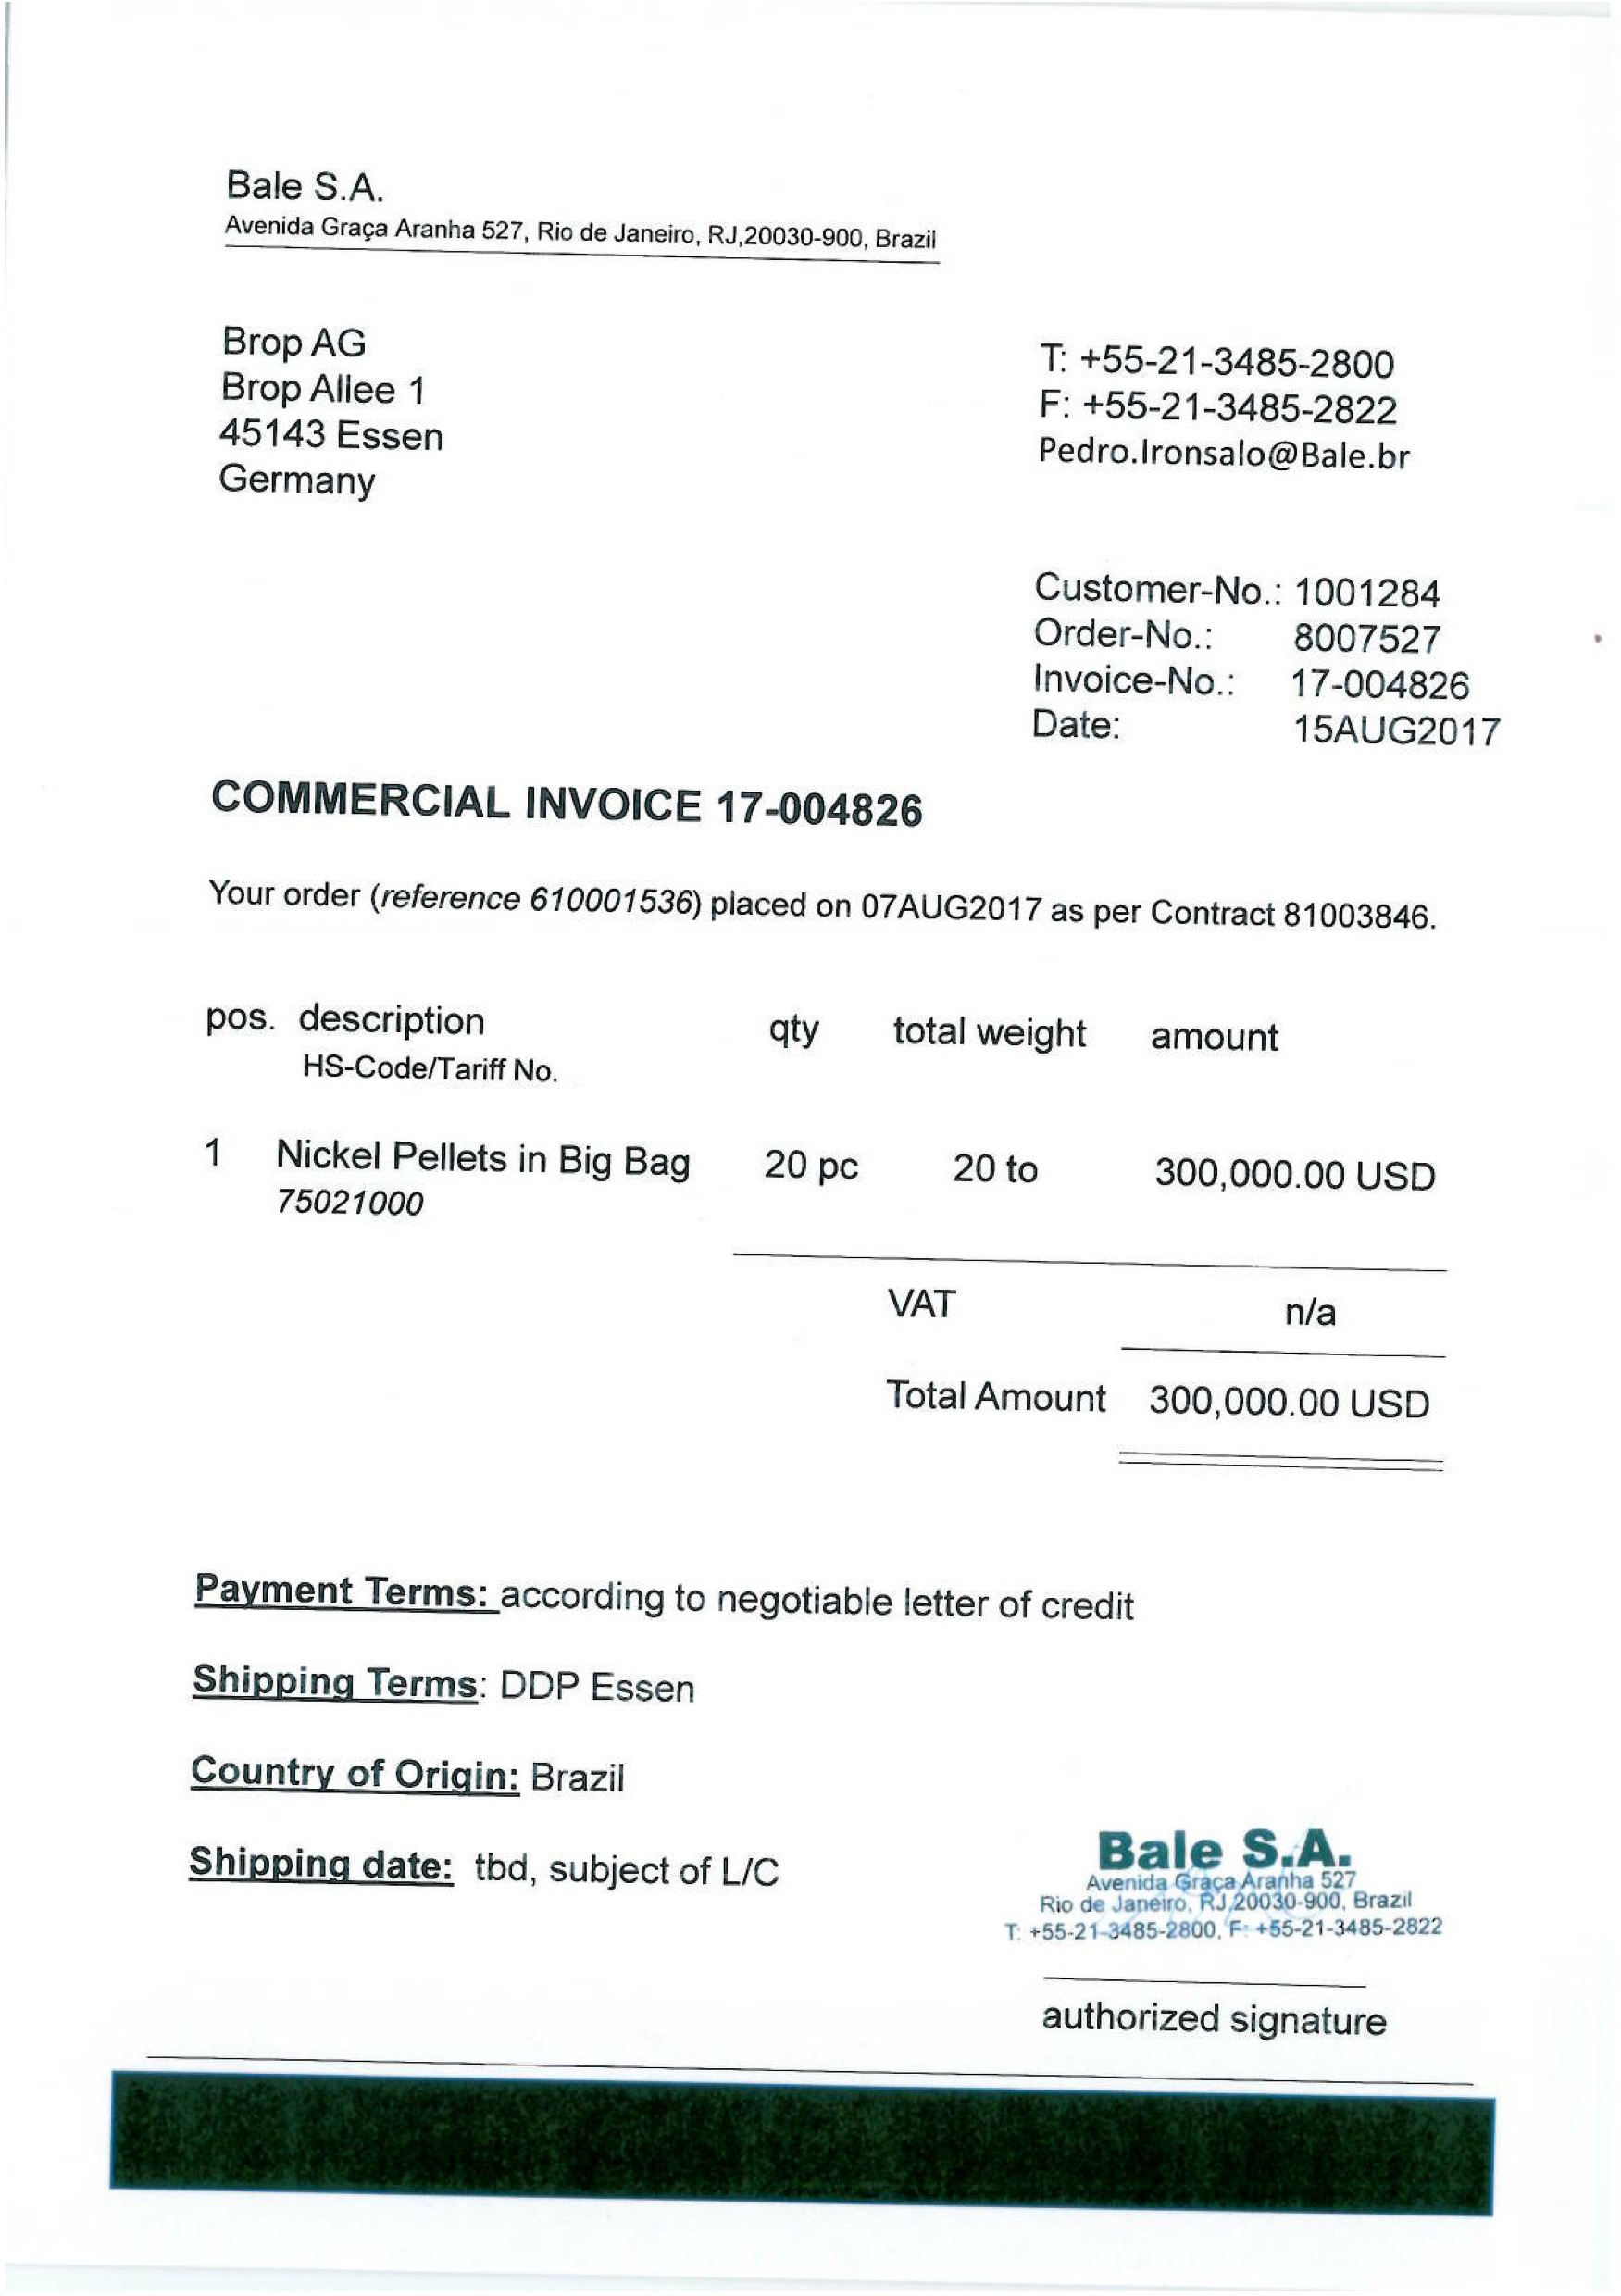
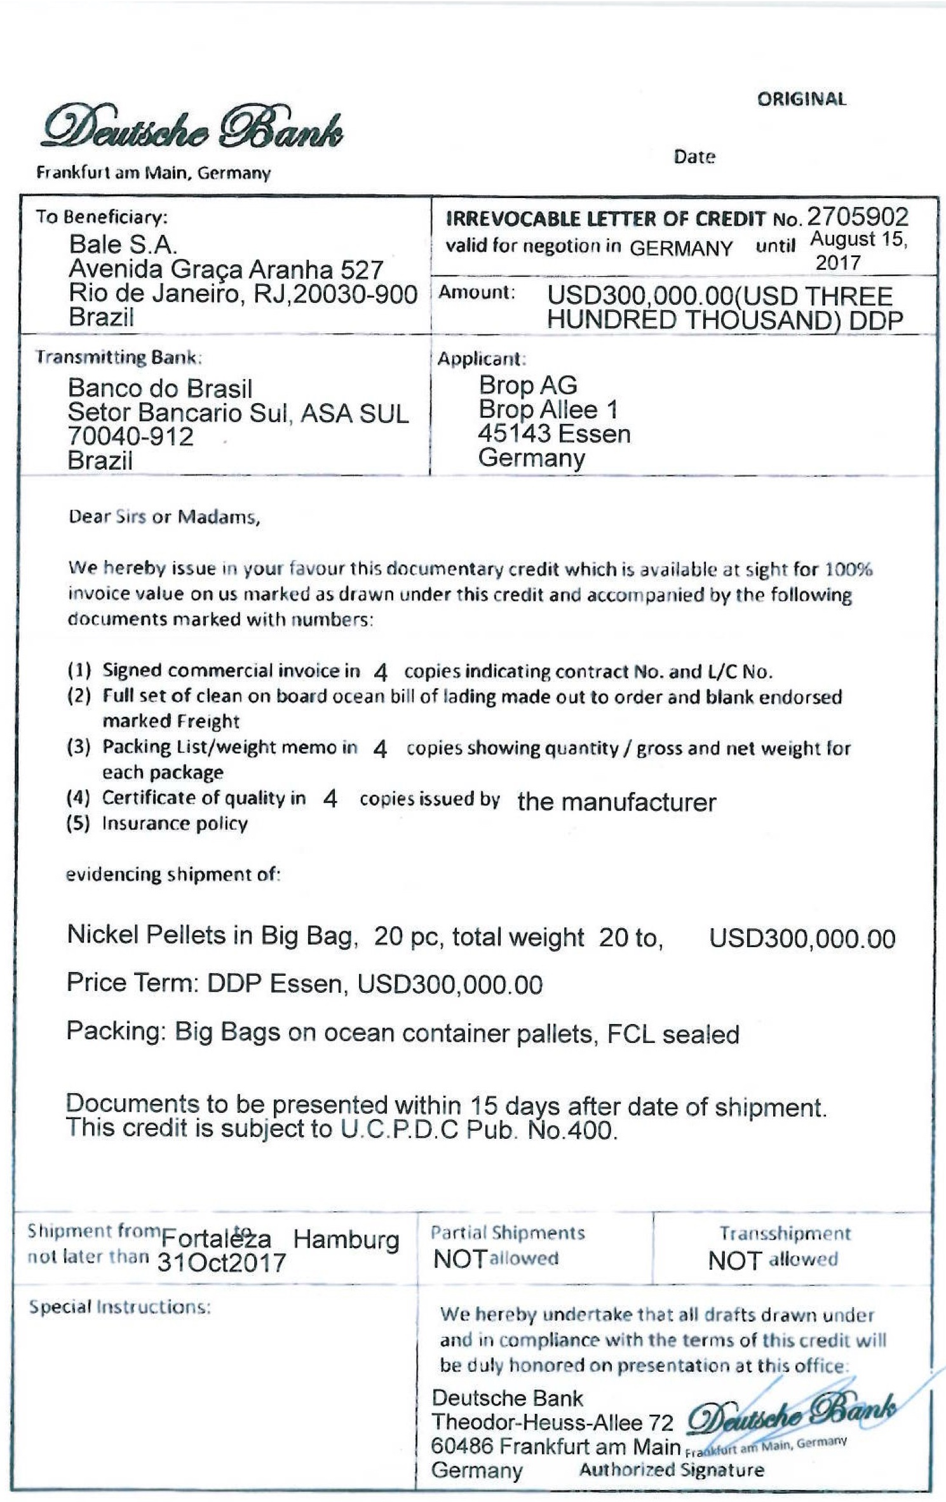
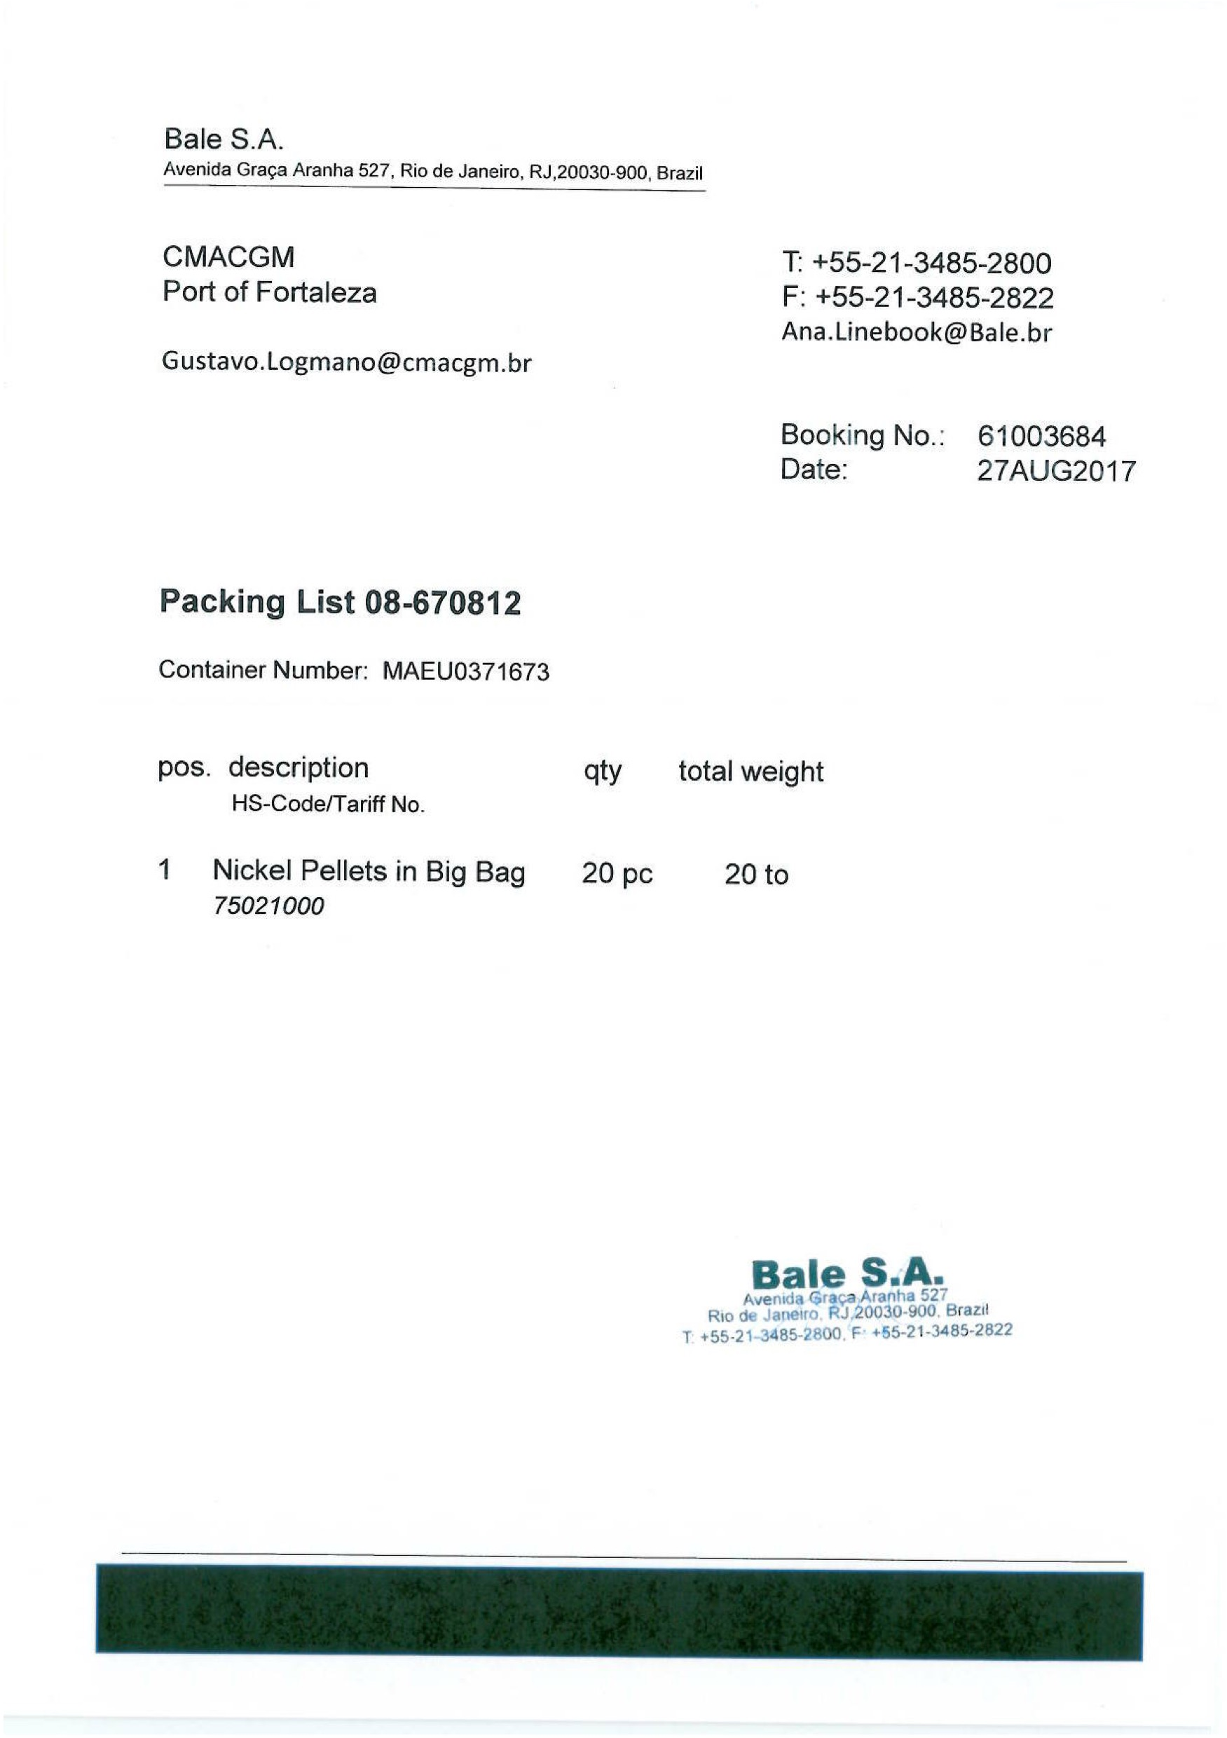
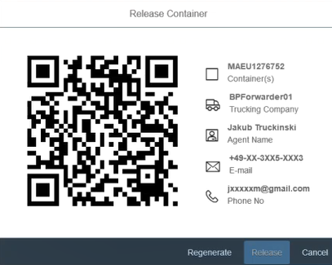

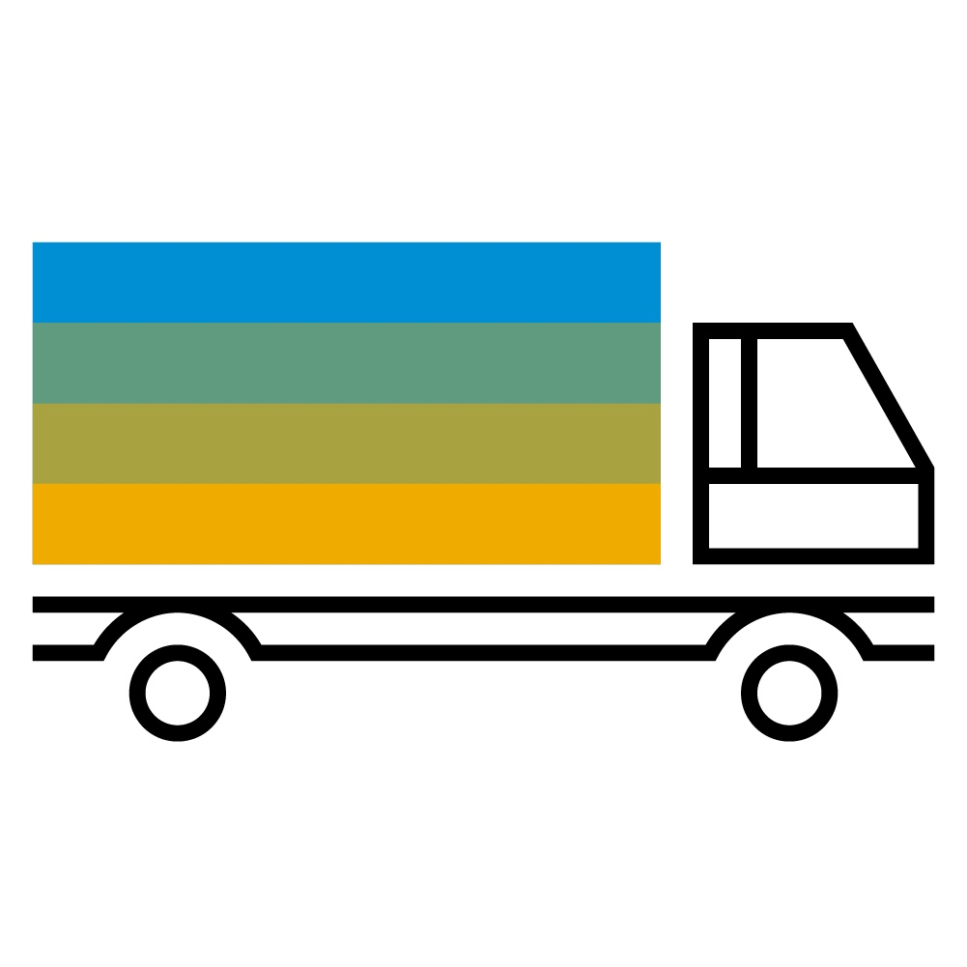






Blockchain for International Trade
PLANNED
Cloud Platform Blockchain Service
Ocean Shipping Blockchain
✓
✓
✓
✓
Initiate Trade
Initiate Shipment
Shipment Delivery
Trade Settlement
TAMPERPROOF
Process & Ownership Trail
DIGITAL
Data, Documents, Transactions
Letter of Credit, Commercial Invoice..
Packing List, Export Declaration..
Bill of Lading
Import Declaration, Release Order
Pick-up Driver Assignment
Identity Check, Secure Container Release
Export Customs Clearance
Import Customs Clearance
SECURE Partner Access

